Slide 1
CS-2001 Data Structures
Binary Trees

Slide 2
Topics
Binary trees
properties
Full Binary Tree
Complete Binary Tree
Binary Search Trees
operations and applications
skewness and issues
Multi-way Trees/Tries

Slide 3
Tree Data Structure
A tree is a non linear data structure that simulates a hierarchical tree structure with a root value and sub trees of children with parent node, represented as set of linked nodes.
Root – Root is a special node in a tree. The entire tree is referenced through it. It does not have a parent.
Parent Node – Parent node is an immediate predecessor of a node.
Child Node – All immediate successors of a node are its children.
Siblings – Nodes with the same parent are called Siblings.
Leaf – Last node in the tree. There is no node after this node.
Edge – Edge is a connection between one node to another. It is a line between two nodes or a node and a leaf.
Path – Path is a number of successive edges from source node to destination node.

Slide 4
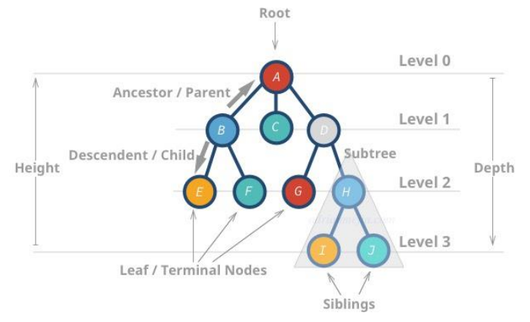
Terminologies

Slide 5
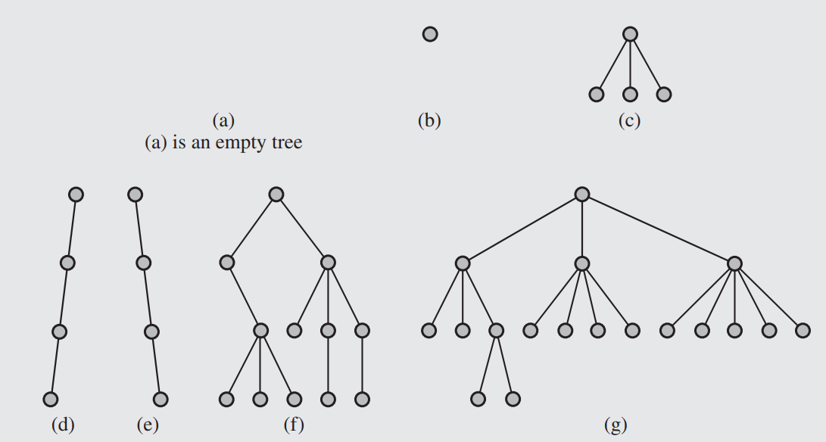
Examples of trees

Slide 6
Tree Properties
Tree can be termed as a RECURSIVE data structure.
In a valid tree for N Nodes we have N-1 Edges/Links
Depth of Node – Depth of a node represents the number of edges from the tree’s root node to the node.
Height of Node – Height of a node is the number of edges on the longest path between that node & a leaf.
Height of Tree – Height of tree represents the height of its root node.

Slide 7
Binary Tree
A binary tree is a tree data structure in which each node has at most two children, which are referred to as the left child(LC) and the right child(RC).
Binary Tree Terms & Properties
A binary tree is called STRICT/PROPER/Full binary tree when each node has 2 or 0 children.
A binary tree is called COMPLETE binary tree if all levels except the last are completely filled and all nodes are as left as possible.
Max number of nodes at a given level ‘x’ = 2^x
For a binary tree, maximum number of nodes with height ‘h’ = 2^(h+1) – 1
A binary tree is called BALANCE binary tree, if the difference between the height of left subtree and right subtree for every node is not more than k(usually k=1)

Slide 8
Binary SEARCH Tree (BST)
Binary search tree (BST) is a binary tree data structure, in which the values in the left sub-trees of every node are smaller and the values in the right sub-trees of every node are larger.
bool isTreeEmpty() → check if empty
void insertNode(TreeNode *new_node)→insertion
depth first traversal approach
void printPreorder (TreeNode* r) → print & traverse
void printInorder (TreeNode* r) → print & traverse
void printPostorder (TreeNode* r) → print & traverse
void print2D(TreeNode *r, int space) → print & traverse
breadth first traversal approach
void printLevelOrder (TreeNode *r) → print & traverse
TreeNode* search(TreeNode* r, int v) → search
TreeNode* minValueNode(TreeNode node) → delete
TreeNode* deleteNode(TreeNode* r, int v) → delete

Slide 9
Insertion Operation
void insertnode(new_node)
if root == null then →root = new_node
else
set temp=root
while temp != null
if new node.value == temp.value
then → return // no duplicates allowed
else if (new_node.value < temp.value) && (temp.left == null)
then → temp.left = new_node // value inserted on left
break // get out of the function
else if (new node.value < temp.value)
then →temp = temp. left
else if (new_node.value > temp.value) && (temp.right == null)
then → temp.right = new_node // value inserted on right
break // get out of the function,
else temp = temp.right
end while
end if

Slide 10
Add new node in BST using Recursion
// Recursive function to insert a new node in the BST
Node* insert(Node* root, int key) {
// If the tree is empty, return a new node
if (root == nullptr) {
return new Node(key);
}
// Check for duplicates
if (key == root->key) {
return root;
// No duplicates allowed
}
// Otherwise, recur down the tree
if (key < root->key) {
root->left = insert(root->left, key);
}
else { root->right = insert(
root->right, key);
}
// Return the (unchanged) node pointer
return root;
}

Slide 11
Traversal Techniques
Tree traversal also known as tree search and walking the tree refers to the process of visiting (checking and/or updating each node in a tree data structure, exactly once. Such traversals are classified by the order in which the nodes are visited.
Depth-first search/traversal (DFS) These searches are referred to as depth-first search (DFS), since the search tree is deepened as much as possible on each child before going to the next sibling.
Pre-order (NLR)
In-order (LNR)
Post-order (LRN)
Breadth-first search/traversal (BFS) Trees can also be traversed in level-order, where we visit every node on a level before going to a lower level. This search is referred to as breadth-first search (BFS), as the search tree is broadened as much as possible on each depth before going to the next depth.

Slide 12
Pre-order (NLR) (node - left-right)
Access the data part of the current node.
Traverse the left subtree by recursively calling the pre-order function.
Traverse the right subtree by recursively calling the pre-order function.
Pre-order (Pseudocode)
void printPreorder(TreeNode* r)
{
IF r==NULL THEN → return
PRINT r→value
printPreorder(r→left)
printPreorder(r→right)
}

Slide 13
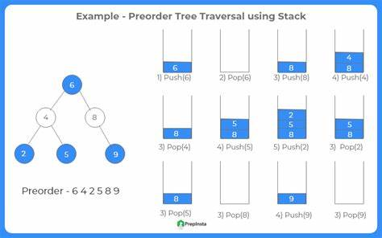
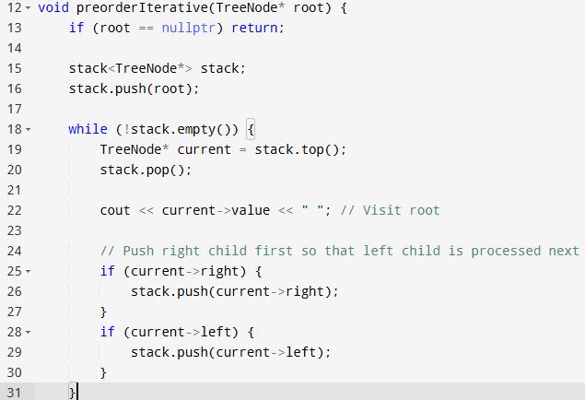

Slide 14
In-order (LNR) (left - node - right)
Traverse the left subtree by recursively calling the in-order function.
Access the data part of the current node.
Traverse the right subtree by recursively calling the in-order function.
In BST in-order traversal retrieves the keys in ascending sorted order.
In-Order (Pseudocode)
void printinorder(TreeNode*r)
{
IF r==NULL THEN → return
printlnorder(r→left)
PRINT r→value
printlnorder(r→right)
}

Slide 15
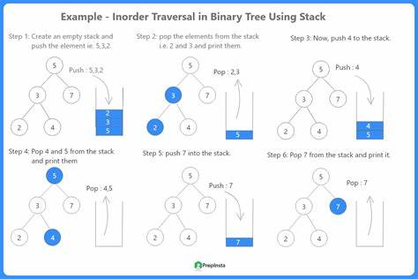
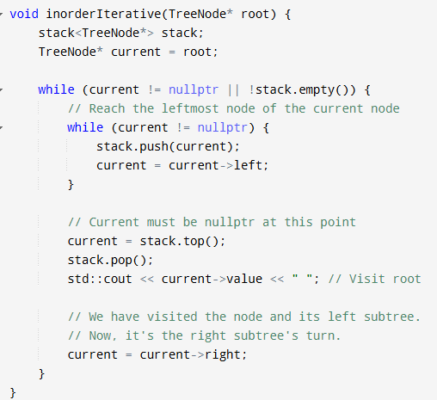
Inorder Traversal (Loop)

Slide 16
Post-order (LRN) (left-right - node)
Traverse the left subtree by recursively calling the post-order function.
Traverse the right subtree by recursively calling the post-order function.
Access the data part of the current node.
Post-Order (Pseudocode)
void printPostorder(TreeNode* r)
{
IF r==NULL THEN→ return
printPostorder(r→left)
printPostorder(r→right)
PRINT r→value
}

Slide 17
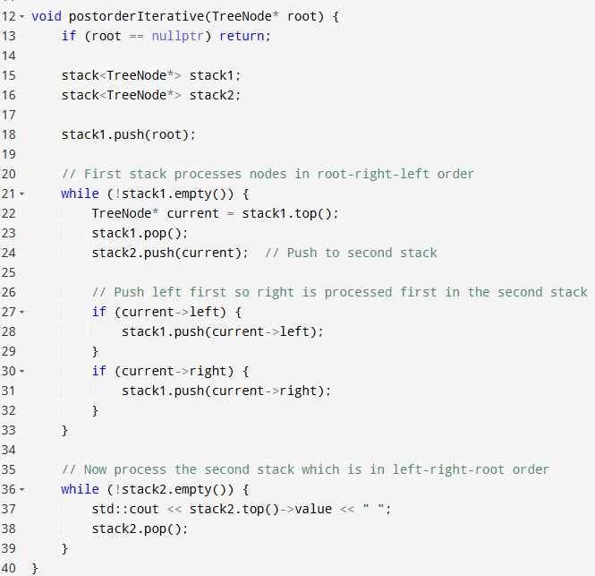
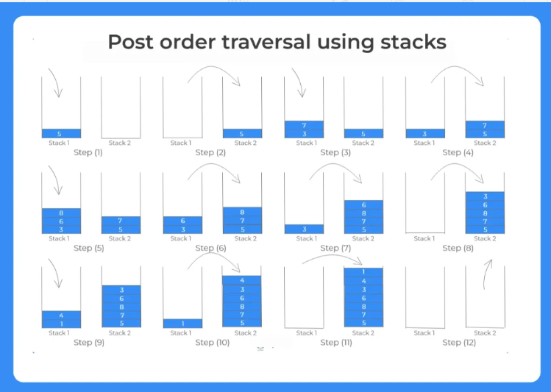

Slide 18
Search Operation in (BST)
treenode* iterativesearch(val)
{
if root==null then→return root
else
set temp=root
while temp!=null
if val == temp.value
then → return temp
else if val<temp.value
then → temp = temp.left
else
temp = temp.right
end while
return null
}

Slide 19
Height of (BST)
int height(treenode* r)
{
if r==null then → return -1
else
{
lheight = height(r→left)
rheight=height(r→right)
if lheight>rheight
then → return lheight+1
else
then → return rheight+1
}
}

Slide 20
Breadth First Search (BFS)
void printLevelOrderBFS(TreeNode *r)
{
h= height(r) // calculate height of tree
FOR i=0 to i<=h
printGivenLevel( r,i )
}
void printGivenLevel(TreeNode *r, int level)
{
IF r==NULL THEN → return
ELSE IF level==0
PRINT(r→value)
ELSE
printGivenLevel(r→left, level-1)
printGivenLevel(r→right, level-1)
}

Slide 21
Delete Node - Cases
For leaf node
Traverse to the leaf node and delete the node.
For node with 1 child
Traverse to the node with single child to be deleted (lets say n).
Check if n has left child (n->left).
If it does not link the right child (n->right) with parent node of n
Check if n has right child (n->right).
If it does not, link the left child(n->left) with parent node of n
For Node with 2 Children
Traverse to the node with 2 children to be deleted (n).
Find the SMALLEST node(nMin) in the right sub tree of n. OR Find the LARGEST node(nMax) in the left sub tree of n.
Replace this node(nMin or nMax) with the node to be deleted (replace n with nMin).
Now delete nMin (or nMax) using the delete process again

Slide 22
Delete Node in BFS
TreeNode* delete Node(TreeNode* r, int v)
{
IF r==NULL //Base Condition
THEN → return r
ELSE IF v < r→ value THEN → // if value smaller go left sub tree
r→ left = delete Node(r→ left, v)
ELSE IF v >r→ value THEN → // if value larger go right sub tree
r→ right = delete Node(r→ right, v)
ELSE // if value matches
IF r→ left==NULL THEN → // node with only right child, //OR no child
temp = r→ right
delete r
return temp
ELSE IF r→ right==NULL THEN →//node with only left child, //OR no child temp = r→ left
delete r
return temp
ELSE // node with TWO children
temp = minValueNode(r→ right)
r→ value = temp→ value
r→ right = delete Node(r→ right, temp→ value)
return
}
TreeNode * minValueNode(TreeNode * node)
{
TreeNode * current = node;
/* loop down to find the leftmost leaf */
while (current → left != NULL) {
current = current → left;
}
return current;
}

Slide 23
Issues of BST
The main disadvantage is that we should always implement a balanced binary search tree. Otherwise the cost of operations may not be logarithmic and degenerate into a linear search on an array.
Accessing the element in BST is slightly slower than array.
A BST can be imbalanced or degenerated which can increase the complexity.
It employs recursive approach which requires more stack space.
The interaction of binary search with memory hierarchy i.e. caching is poor. (because of its random access nature)

Slide 24
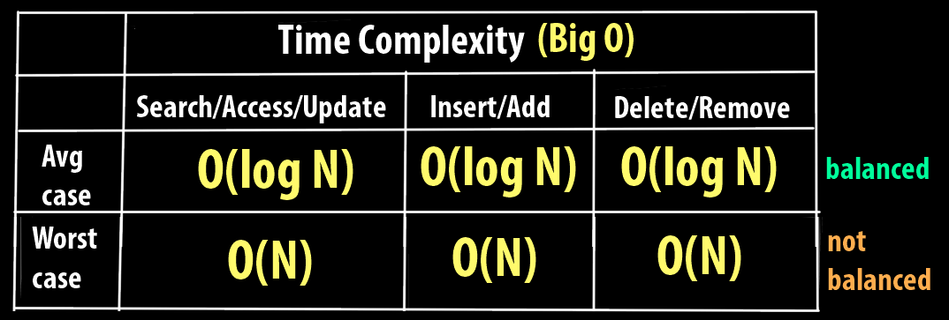
Time Complexity

Slide 25
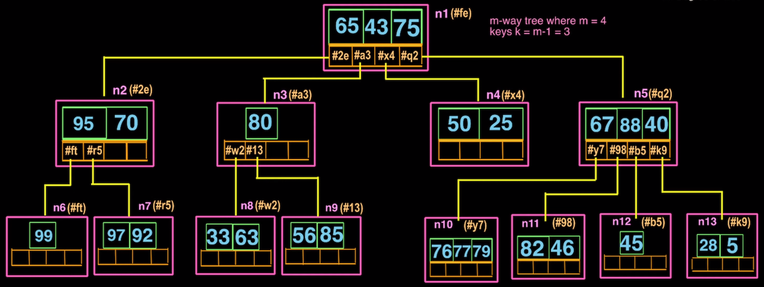
Multi-way Trees/Tries
A multiway tree is a tree that can have more than two children. A multiway tree of order m (or an m-way tree) is one in which a tree can have m children. As with the other trees that have been studied, the nodes in an m-way tree will be made up of key fields, in this case m-1 key fields, and pointers to children.
Biggest advantage of m-way tree over binary tree is short height & fast access of nodes, Less traversal overhead.
max elements : m^(h+1) - 1 h: Height of tree
m: Degree of tree
S

Slide 26
Reference
https://prepinsta.com/java-program/preorder-tree-traversal-without-recursion/

